Slide 1
Digital Experience (DX) Challange

Slide 2

The digital experience delivery challenge
Custom Interfaces, APIs, File Transfer Mechanisms, Batch Processing …

Slide 3

The 5 fundamental patterns
A collection of solutions that collectively address the majority of enterprise needs:
1.
Standalone
2.
DXL Invoke℠
3.
DXL Inject℠
4.
DXL Ingest℠
5.
Consumer
We’ll come back to DXL later on…

Slide 4
Simple Use Cases
Discrete Projects

Slide 5


Pattern 1 - Standalone
Complete, self-contained solution, managed entirely within the Crownpeak DXM
DESCRIPTION
A completely self-contained solution, optionally with third-party integrations / dependencies
Customer Managed
SUITABLE FOR
Solutions that are almost exclusively content-focused e.g. Static web/mobile Sites, Marketing Campaigns, Landing Pages, etc.
Solutions requiring minimal software development
Solutions requiring no interaction with customer-hosted internal services
Host
PUBLISH
Presentation Layer
Business Logic
Crownpeak Managed

Slide 6

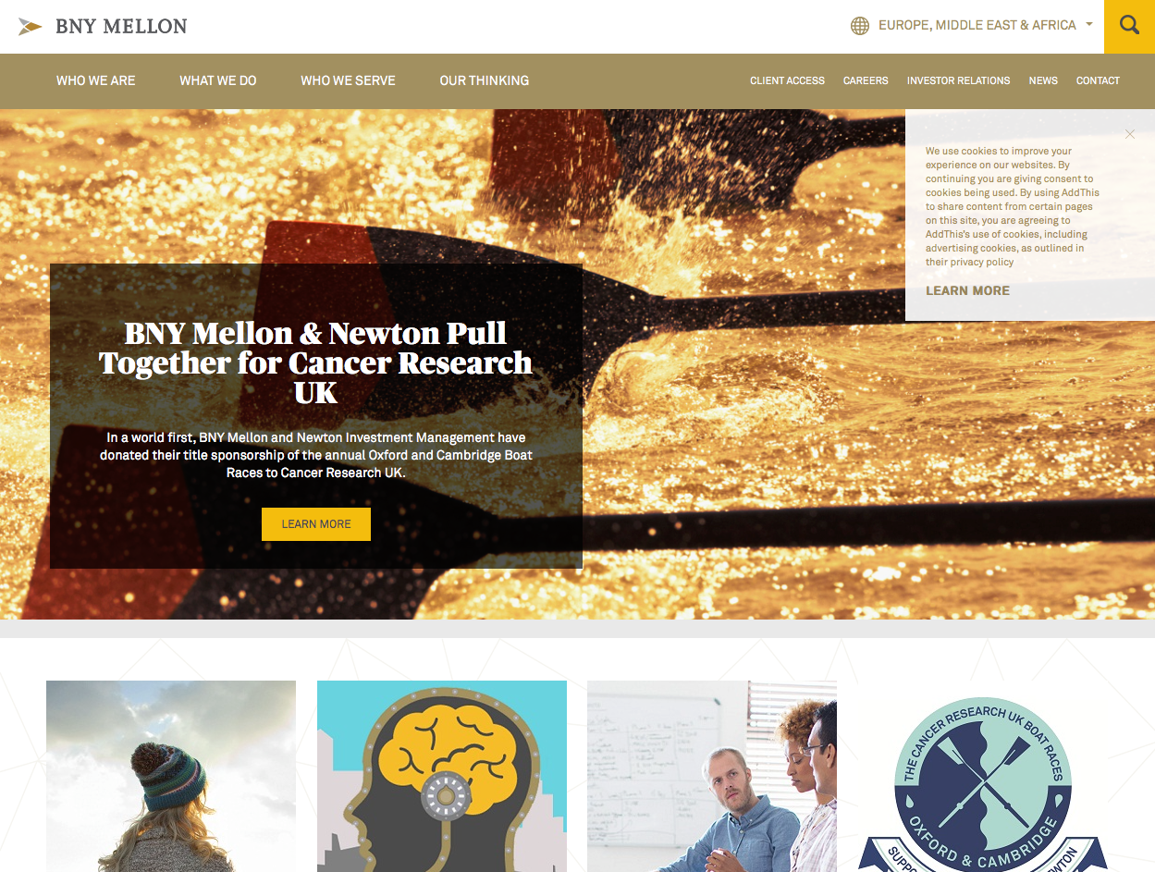

Pattern 1 – Standalone – Case study
Complete, self-contained solution, managed entirely within the Crownpeak DXM
Java web app running on Tomcat web server
Responsive web app & content wholly managed within DXM and deployed to Crownpeak hosting

Slide 7
Pattern 5 – Consumer
Solution incorporating Crownpeak-managed content and services into LOB application using the Crownpeak API
DESCRIPTION
Augmentation of existing business applications with CMS-managed content and services, accessed on-demand using an API
Customer Managed
API
SUITABLE FOR
Host
Existing LOB applications needing advanced digital marketing content capabilities
Solutions where direct modification of the existing application carries high risk/cost
Teams with strong capabilities in modern CMS-independent development frameworks
Single-page, client-side applications
Presentation Layer
Business Logic
Crownpeak Managed

Slide 8
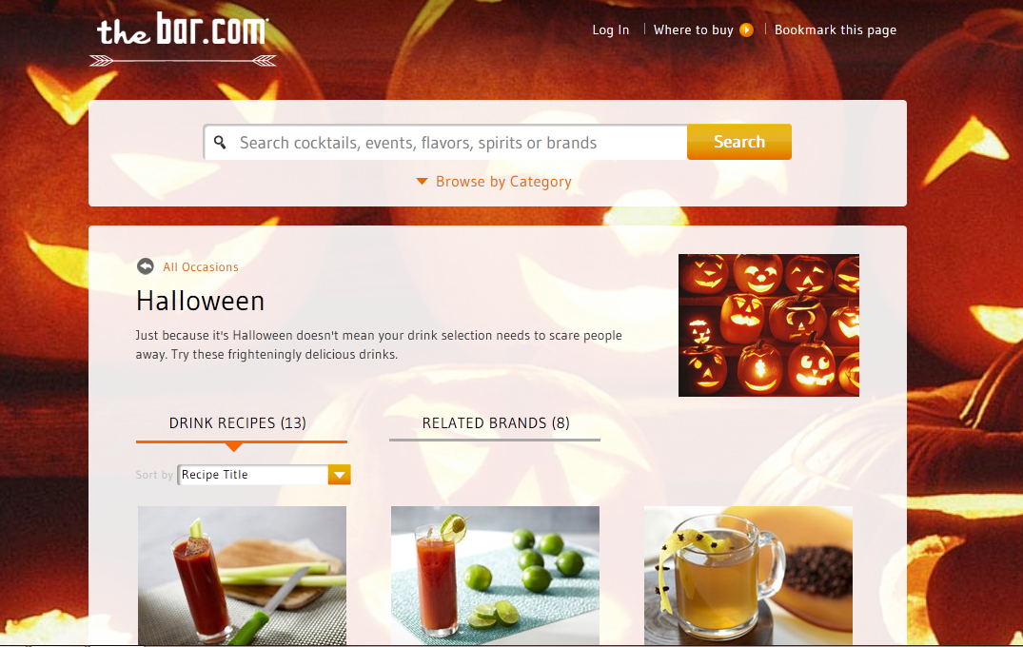
Pattern 5 – Consumer – Case study
Solution incorporating Crownpeak-managed content and services into LOB application using the Crownpeak API
application deployment service
Highly dynamic site, completely driven from a single page, delivered exclusively via Crownpeak Search API
Typeahead search for any event, occasion and/or drink. Cocktail recipes retrieved in real time from Database.com (SFDC). Background style/palette changed in real time

Slide 9
More Complex Use Cases
Delivering modern experiences against legacy systems

Slide 10
Pattern 2 – DXL Invoke℠
Presentation layer deployed from Crownpeak DXM as a standalone façade, interacting with LOB application via a service API
DESCRIPTION
An independent presentation layer, that handles user interaction on behalf of a LOB application and communicates with that application via a defined API
Customer Managed
Host
SUITABLE FOR
Business Logic
Solutions with significant and/or complex business logic
Business applications that offer a full API, supporting both business logic transactions and data exchange
Use cases requiring a variety of presentation treatments for a given business application – device and language
Solutions where direct modification of the existing application carries high risk/cost
PUBLISH
Host
Presentation Layer
API
Crownpeak Managed

Slide 11

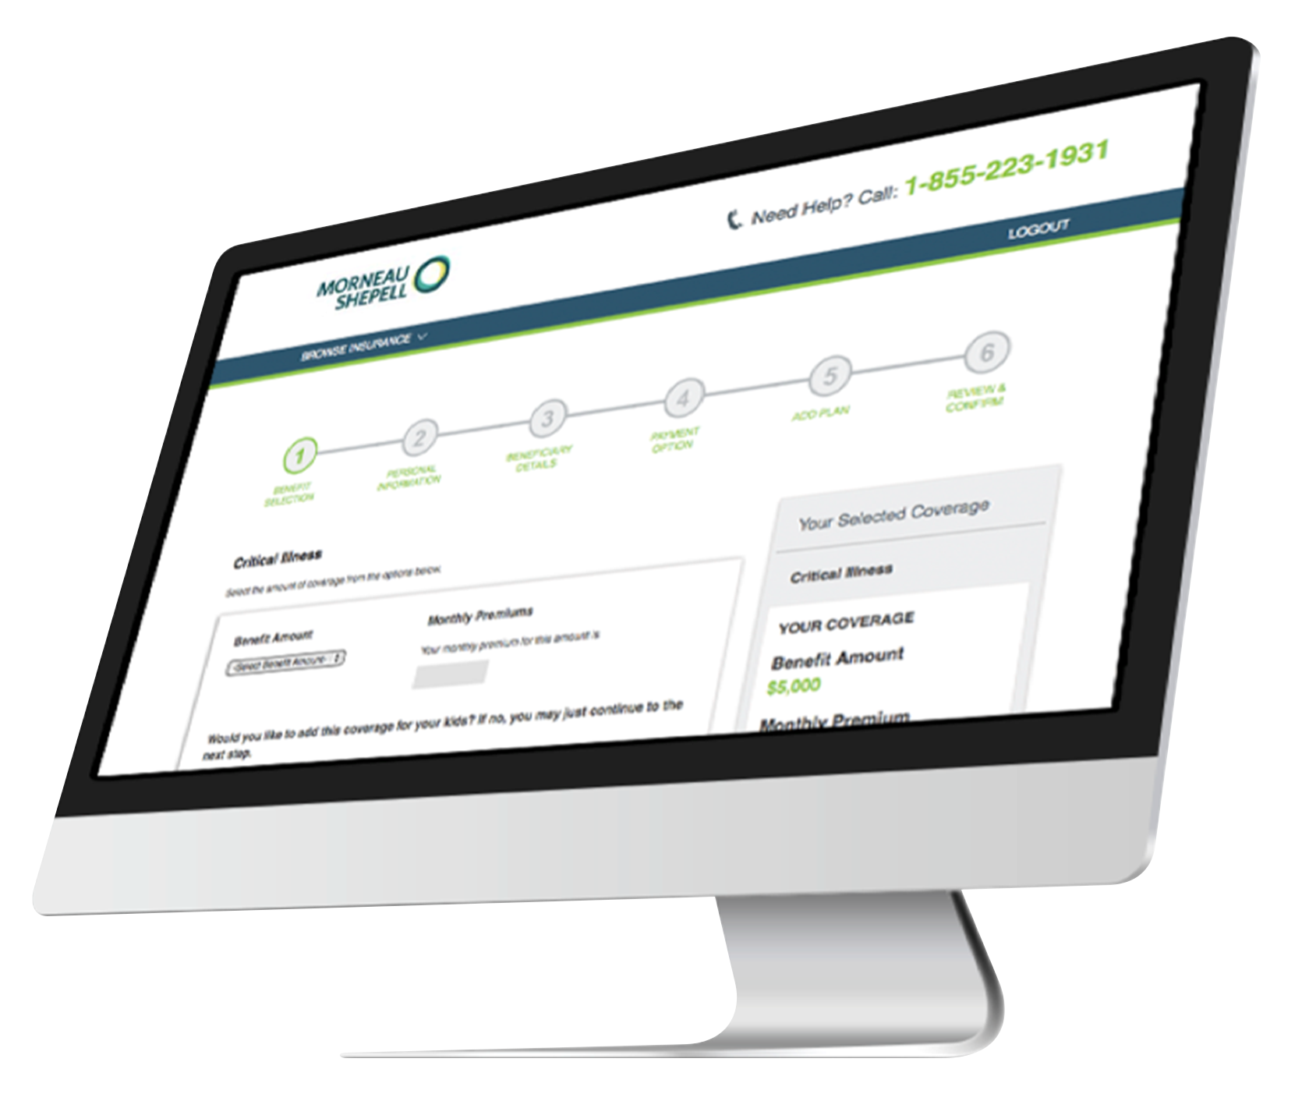
Pattern 2 – DXL Invoke℠ – Case study
Presentation layer deployed from Crownpeak DXM as a standalone façade, interacting with LOB application via a service API
Full-feature presentation UI layer deployed to web server in front of legacy IBM WebSphere™ insurance claims service application
Adds responsive / device-specific capabilities and integrated CDN acceleration
All business functionality implemented via calls to core application service API

Slide 12
Pattern 3 – DXL Inject℠
Presentation layer delivered from Crownpeak DXM directly into LOB application environment
DESCRIPTION
Deployment of presentation components (pages, CSS, JS) based on any technology directly into existing LOB application
Customer Managed
PUBLISH
Host
SUITABLE FOR
Solutions with significant and/or complex business logic
Business applications lacking a full API
Established, stable, legacy LOB applications in maintenance mode
Use cases requiring a variety of presentation treatments for a given business application – device and language
Solutions where direct modification of the existing application carries high risk/cost
Presentation Layer
Business Logic
Crownpeak Managed

Slide 13
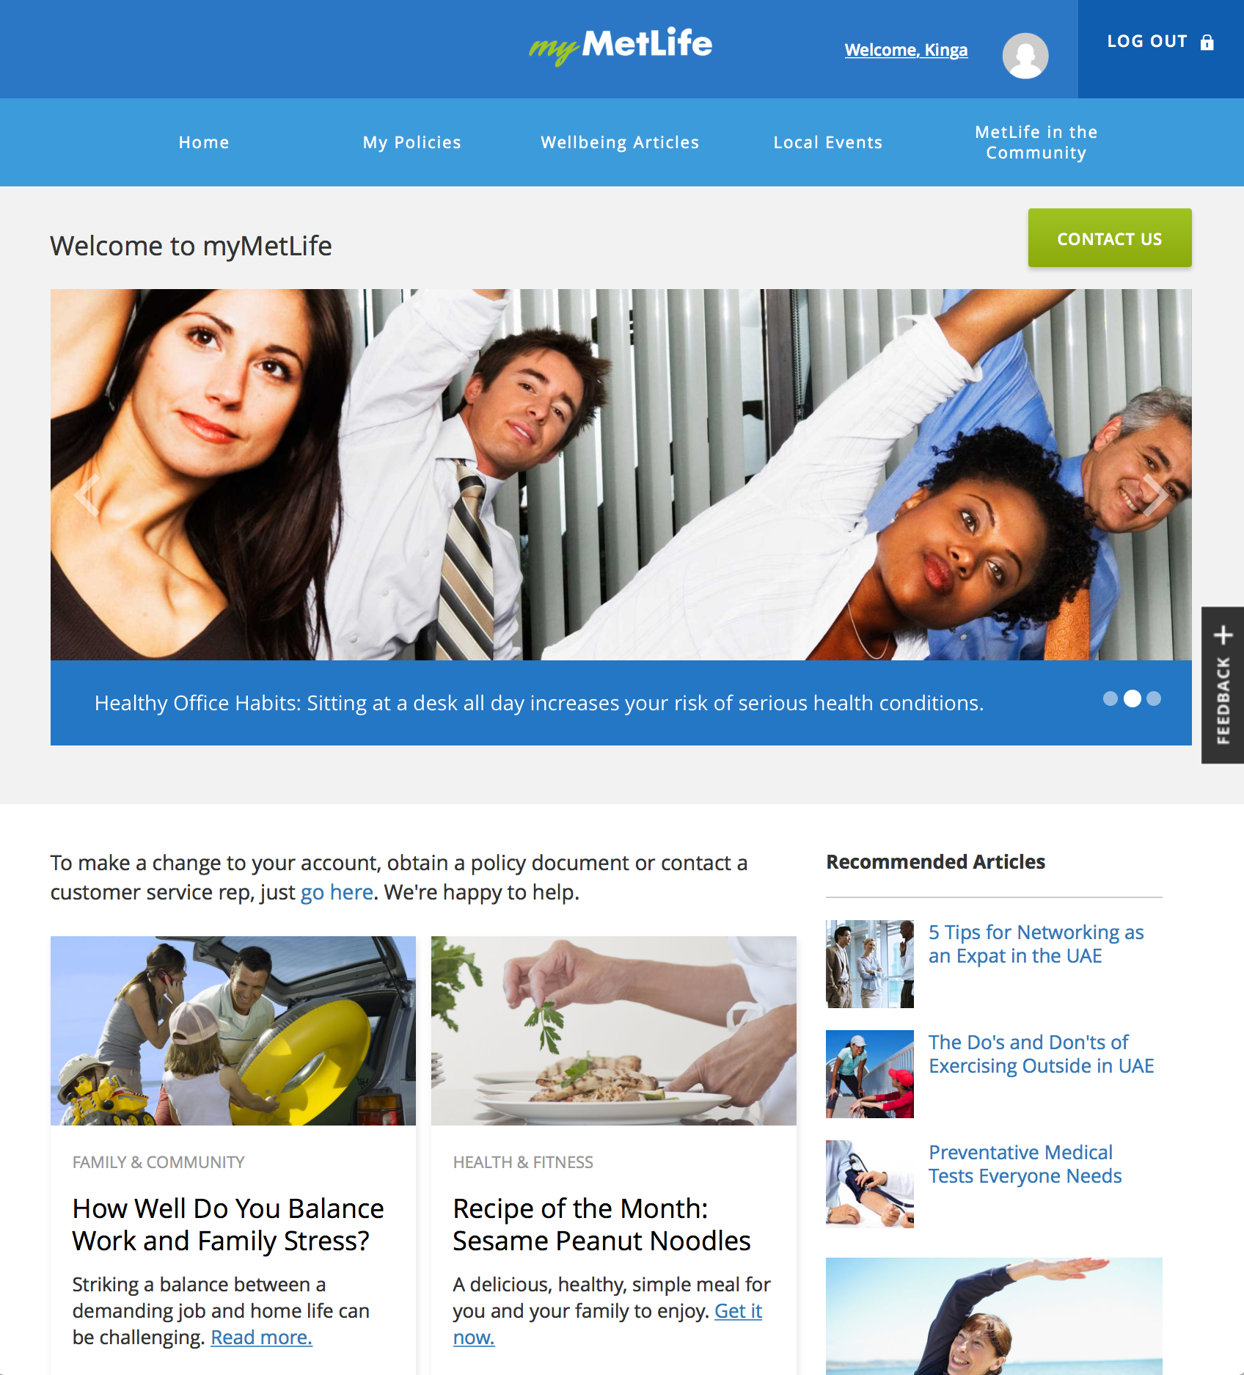

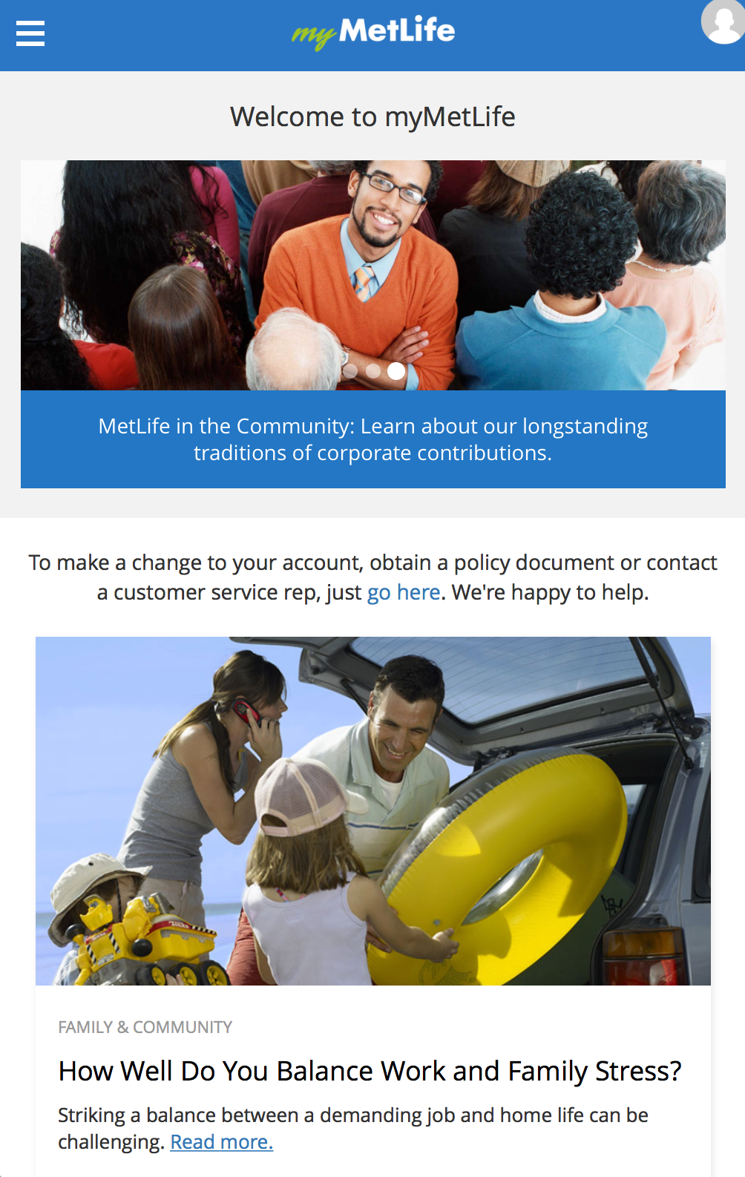
Pattern 3 – DXL Inject℠ – Case study
Presentation layer delivered from Crownpeak DXM directly into LOB application environment
Presentation layer injected directly into LOB WebSphere application, hosted within customer managed environment
Implements navigation, brand identity, CMS-managed personalized messaging

Slide 14
Pattern 4 – DXL Ingest℠
Packaged business logic, shipped into Crownpeak-managed presentation environment using industry-standard application deployment service
DESCRIPTION
Import of packaged business logic into a standalone presentation environment to deliver advanced dynamic functionality
Customer Managed
SUITABLE FOR
PUBLISH
SDLC
Process
Solutions with significant and/or complex business logic
Solutions where the business logic is owned and maintained by a separate department / organization
Solutions where application development and marketing activities must be able to operate on different cycles
Solutions with well-defined interface contracts between presentation and business logic components
Rapid on-boarding of existing web applications into managed CMS
Host
Presentation Layer
Business Logic
Business Logic
PACKAGE DEPLOY
Crownpeak Managed

Slide 15
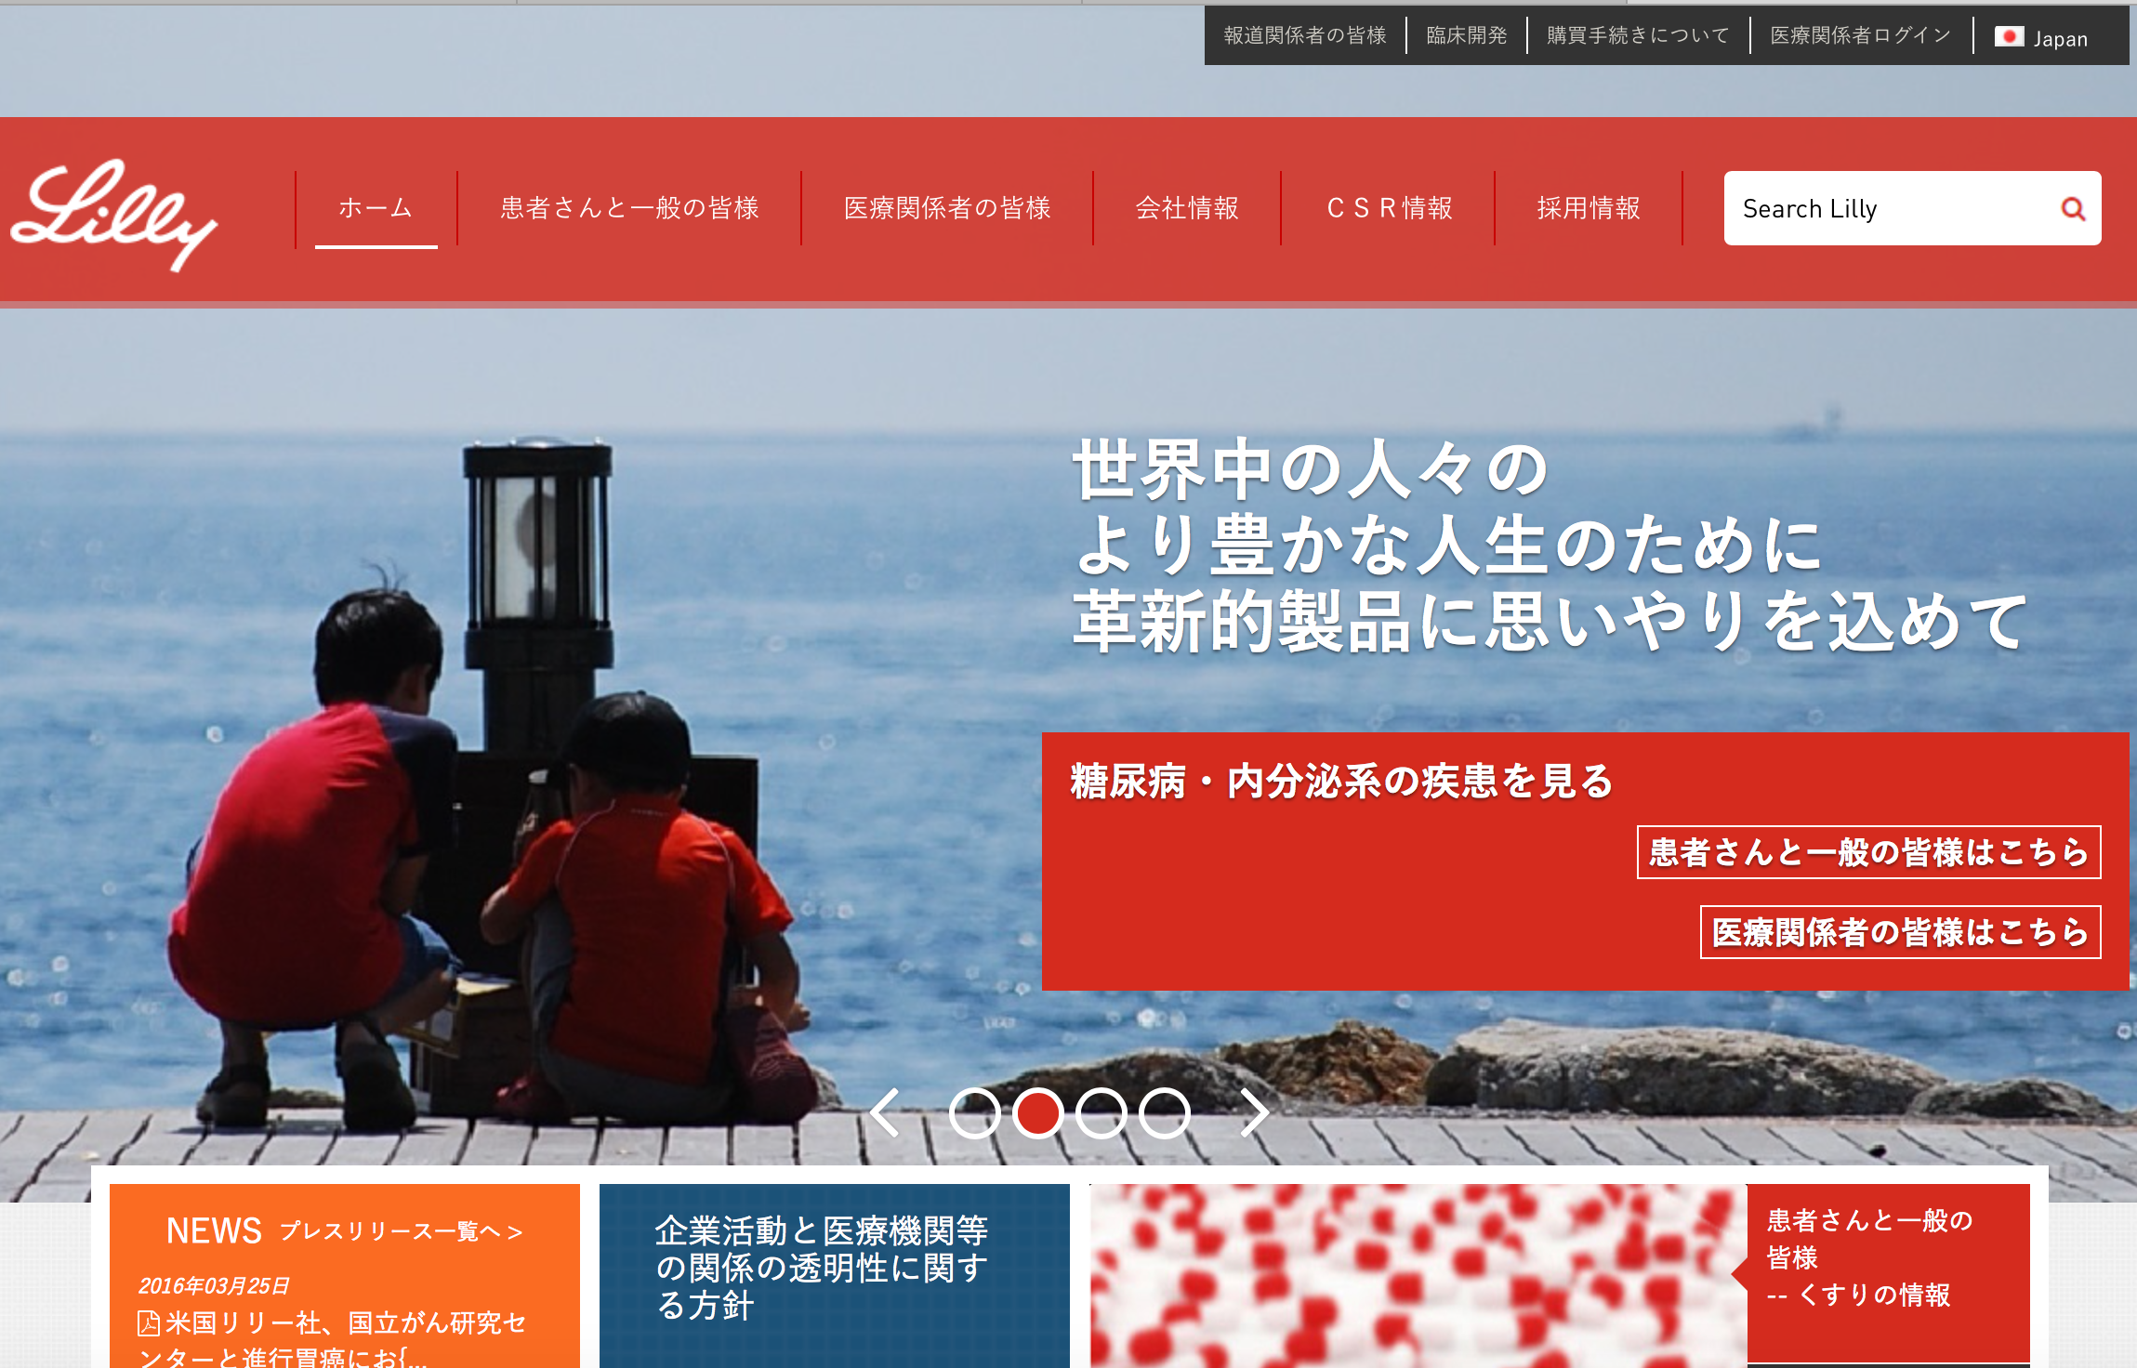

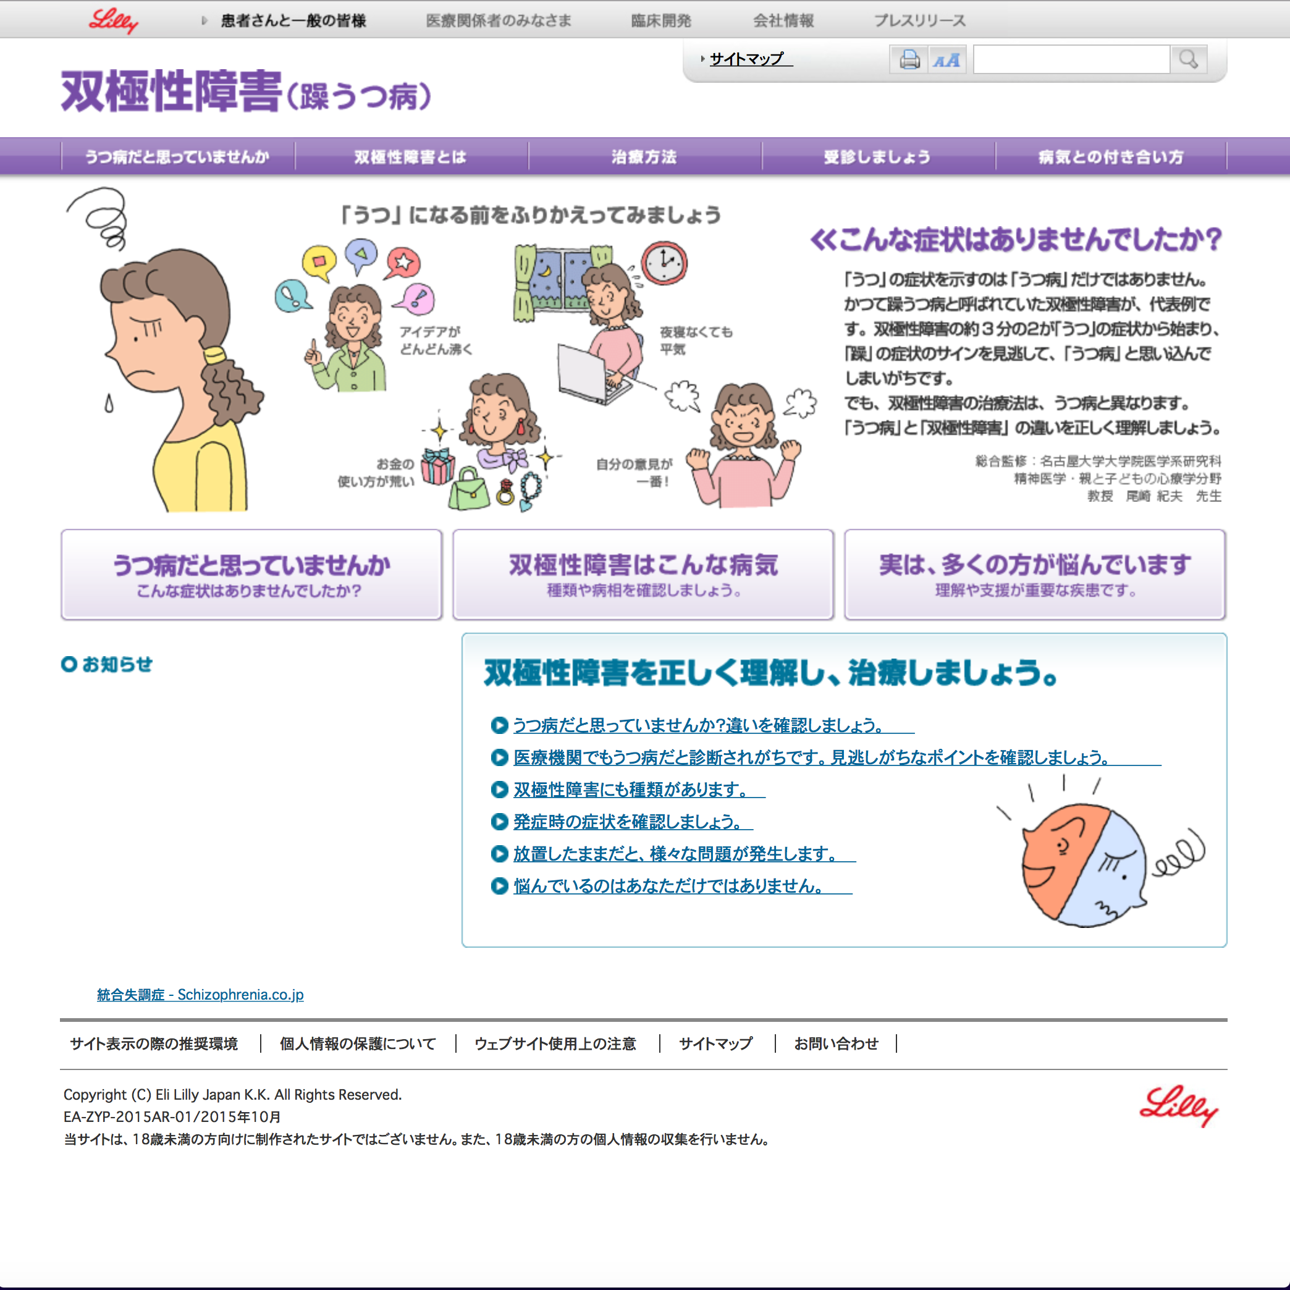

Pattern 4 – DXL Ingest℠ – Case study
Packaged business logic, shipped into Crownpeak-managed presentation environment using industry-standard application deployment service
Complex, proprietary, multi-realm SSO authentication technology (SAML, social, third-party)
Deployed to Crownpeak managed hosting environment via Crownpeak Package Deploy and incorporated into 30+ website application suite

Slide 16
The 5 fundamental patterns A collection of solutions that collectively address the majority of enterprise needs
Digital Experience Layer℠
1.
Standalone
2.
DXL Invoke℠
3.
DXL Inject℠
4.
DXL Ingest℠
5.
Consumer

Slide 17
The Crownpeak Digital Experience Layer^{sm}
Crownpeak Digital Experience Layer^{sm}

Slide 18
Developer Training
Introduction to Crownpeak

